Slide 1
Voting Rules
Oluwanifemi Olajuyigbe and Sara Saad
https://github.com/saracherif123/voting_rules_in_python

Slide 2
Question 5 :The problem
Requirements:
- n ≥ 60 voters
- m ≥ 8 candidates
- Same winner for: Plurality, Plurality Runoff, Condorcet, Borda
- Constraints: ≤50% same best candidate, ≤40% same worst candidate
Is it possible to elaborate an election example with
n ≥60 and m ≥8 where the winner is the same for the four voting rules Plurality, Plurality with Runoff, Condorcet Principle and Borda rules ?
In your example, no more than 50% of voters has the same “best candidate” and no more than 40% of voters has the same “worst candidate”..

Slide 3
The Four Voting Methods
Election Setup
Plurality Voting: The candidate who gets the most first-choice votes wins, even if they don’t have a majority.
Plurality with Runoff: If no candidate has a majority, the top two go to a second round; the one with more votes in that round wins.
Condorcet Principle: The winner is the candidate who would beat every other candidate in head-to-head comparisons.
Borda Count: Voters rank all candidates; points are assigned based on rank (e.g., first place = most points), and the candidate with the highest total wins.
n = 60 voters
m = 8 candidates: A, B, C, D, E, F, G, H
Constraints:
✓ Best candidate (first choice): 28/60 = 46.7% ≤ 50%
✓ Worst candidate (last choice): 22/60 = 36.7% ≤ 40%

Slide 4
VOTER PREFERENCES
Group 1: 15 voters (25.0%) - A for PLURALITY
A ≻ B ≻ C ≻ D ≻ E ≻ F ≻ G ≻ H
• A first (gives A first-place votes for Plurality)
• B, C, D ranked high (helps A in Borda - A gets points from being ranked high)
• H ranked last (diversifies worst candidate to satisfy ≤40% constraint)
• A consistently ranked first or second across groups (ensures A wins in all methods)
Group 2: 13 voters (21.7%) - A for PLURALITY (additional support)
A ≻ B ≻ C ≻ D ≻ E ≻ F ≻ H ≻ G
• A first (more first-place votes - total A first = 28 = 46.7% < 50%)
• B, C, D ranked high (helps A in Borda)
• G ranked last (diversifies worst candidate - G = 13 voters = 21.7% < 40%)
• Combined with Group 1, A gets 28 first-place votes (most, but under 50% constraint)
Group 3: 15 voters (25.0%) - A for BORDA and CONDORCET
-------------------------------------------------------
B ≻ A ≻ C ≻ D ≻ E ≻ G ≻ H ≻ F
• B first (keeps B competitive, but A still wins Plurality)
• A second (crucial for Borda - A gets 6 points per voter in this group)
• A beats B pairwise (for Condorcet - A is preferred over B by Groups 1, 2, 4, 5 = 45 voters)
• F ranked last (diversifies worst candidate - F = 15 voters = 25% < 40%)
• A ranked high enough to accumulate Borda points while still beating B in pairwise
Group 4: 10 voters (16.7%) - A for BORDA and CONDORCET
------------------------------------------------------
C ≻ A ≻ D ≻ B ≻ F ≻ G ≻ H ≻ E
• C first (some first-place support for C)
• A second (more Borda points for A - 6 points per voter)
• A beats C pairwise (for Condorcet - A preferred by Groups 1, 2, 3, 5 = 50 voters)
• E ranked last (diversifies worst candidate - E = 10 voters = 16.7% < 40%)
• D ranked third (helps balance, but A still wins overall)
Group 5: 7 voters (11.7%) - A for BORDA and CONDORCET
-----------------------------------------------------
D ≻ A ≻ B ≻ C ≻ E ≻ F ≻ G ≻ H
• D first (some first-place support for D)
• A second (more Borda points for A - 6 points per voter)
• A beats D pairwise (for Condorcet - A preferred by Groups 1, 2, 3, 4 = 53 voters)
• H ranked last (diversifies worst candidate - total H = 22 voters = 36.7% < 40%)
• Ensures A beats all candidates in pairwise comparisons

Slide 5

Results (ALL FOUR METHODS: WINNER = A)
1. PLURALITY VOTING
-------------------
First-place votes:
A: 28 votes (46.7%) ← WINNER
B: 15 votes (25.0%)
C: 10 votes (16.7%)
D: 7 votes (11.7%)
2. PLURALITY WITH RUNOFF
-------------------------
Round 1: A (28), B (15) → advance to Round 2
Round 2: A (45), B (15) ← WINNER: A
3. CONDORCET PRINCIPLE
----------------------
Pairwise comparisons:
A vs B: 45 prefer A
A vs C: 50 prefer A
A vs D: 53 prefer A A beats all others ← WINNER: A
4. BORDA COUNT
--------------
Borda Scores:
A: 388 points ← WINNER
B: 348 points
C: 313 points
D: 271 points
E: 150 points
F: 100 points
G: 72 points
H: 38 points
All four voting methods produce the same winner: A

Slide 6
Question 6 :The problem
Requirements:
- n ≥ 60 voters
- m ≥ 8 candidates
- Different winners for: Plurality, Plurality Runoff, Condorcet, Borda
- Constraints: ≤50% same best candidate, ≤40% same worst candidate
Is it possible to elaborate an election example with n = 60 and m = 8 where the unique winner is not the same for the four voting rules Plurality, Plurality with Runoff, Condorcet Principle and Borda rules (we should have 4 different winners) ?
In your example, no more than 50% of voters has the same “best candidate” and no more than 40% of voters has the same “worst candidate”.

Slide 7
Voter Preferences
Constraints:
✓ Best candidate: 33.3% ≤ 50%
✓ Worst candidate: 33.3% ≤ 40%
n = 60 voters
m = 8 candidates: A, B, C, D, E, F, G, H
Group 1: 20 voters (33.3%) - A for PLURALITY
A ≻ C ≻ D ≻ E≻ F≻ B≻ G ≻ H
A first (most first-place votes)
C and D ranked high (help them for Condorcet/Borda)
B ranked low (hurt B's Borda score)
A ranked middle elsewhere (won't win Borda/Condorcet)
Group 2: 18 voters (30%) - B for RUNOFF
B ≻ D ≻ E ≻ C ≻ F ≻ A ≻ H ≻ G
B first (enough to reach runoff with A)
A ranked very low (so B beats A in runoff)
Rank D higher than C to help D's Borda
Group 3: 12 voters (20%) - C for CONDORCET
C ≻ D ≻ B ≻ E ≻ G ≻ A ≻ H ≻ F
C first (some first-place support)
D second (D gets high rankings for Borda)
B before A to help for runoff
Rank C > D > B > A (C beats all in pairwise)
Group 4: 10 voters (16.7%) - D for BORDA
D ≻ B ≻ C ≻ F ≻ G ≻ A ≻ H ≻ E
D first (some first-place support)
C third (help Condorcet)
KEY: D must appear 2nd or 3rd in other groups.
Each group strategically ranks all candidates to help specific winners

Slide 8
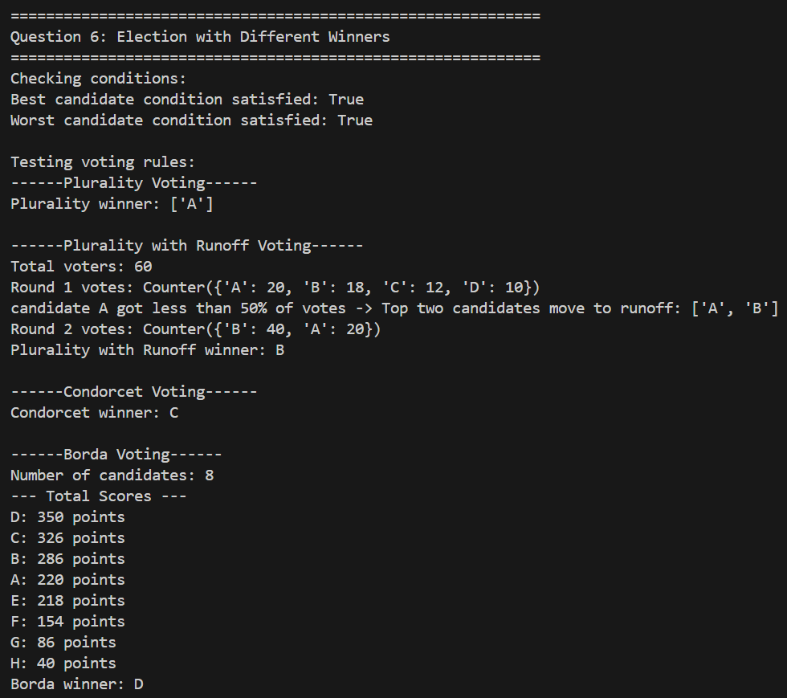
Results
Winners by Voting Rules
Plurality: A (33.3%)
Plurality with Runoff: B
Condorcet: C
C > A : 66.7%
C > B : 53.3%
C > D : 53.3%
Borda: D

